Slide 1

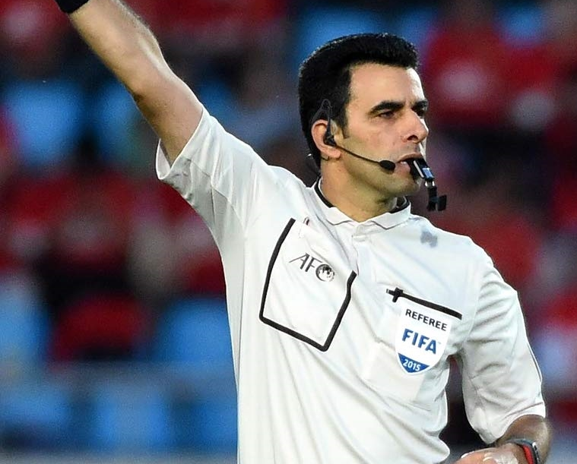
RefComs Pro-90
Programming Basics
Tips & Troubleshooting
Best Practices

Slide 2
RefComs Pro-90 Intercoms…
…use Bluetooth to pair to each other
…do NOT require pairing for each use
…DO require synching after power up to use
…Pair once. Synch to use.

Slide 3
Pro-90
Button Layout

Slide 4
How To Use
Power On:
    press and hold green button till light
Power Off:
    RefComs = press button on bottom
    EJEAS = press and hold red button and A button together
Enter Pair Mode
    hold A or B button till steady flash*
Pair
    press flashing button once
Synch
    RefComs = double press B button on #1 unit
    EJEAS = double press A button on #1 unit
Clear Pairings
    After power up but before synching, press and hold + and – volume buttons simultaneously until quick flash. Repeat. Power unit down.

Slide 5
Successful Synch – 3 Units
Unit 1
    RefComs = slow blue flash
    EJEAS = slow red flash
Unit 2
    slow red/blue flash
Unit 3
    RefComs = slow red flash / EJEAS = slow blue flash

Slide 6
Successful Synch – 4 Units
Unit 1
      RefComs = slow blue flash
      EJEAS = slow red flash
Unit 2
      slow red/blue flash
Unit 3
      slow red/blue flash
Unit 4
      RefComs - slow red flash
      EJEAS - slow blue flash

Slide 7
Prior to leaving home…
Charge up units if needed to ensure proper battery life for matches to be worked
Unless long drive ahead, synch headsets prior to leaving and ensure all are connected
Inspect headsets - ensure they are working and no defects

Slide 8
Tips and Troubleshooting: Pre-Game
Take your time! Allow units to flash five times between steps
If unsuccessful synch…
  power down units
  wait 10 seconds
  power up and repeat double press
If numerous attempts are unsuccessful, clear units and repair as appropriate.

Slide 9
Tips and Troubleshooting: In-Game
Keep Unit 1 with most experienced unit user
If one or more units drop but still have battery life, simply double press on unit 1 again and wait.
Volume ideally set during on field warm-ups and just before final positioning (arm band or pocket)
Avoid adjusting volume or position unless necessary

Slide 10
Pre-Game Tips
Each crew member should perform these actions during pre-game preparations.
  Fit respective unit onto self and perform mic check
  Wear unit during warms ups to ensure comfortable fit
  If required, adjust volume level on field during warm ups

Slide 11
In Game Usage:
The following are selected highlights on proper in-game communication:
    Speak slowly and clearly
    Speak in a short and concise manner
    Whenever possible, use simple one word phrases in triplicate…
        “Foul. Foul. Foul.”
        “Off. Off. Off.”
    Avoid use of the word “No” as it can be unheard due to player or fan reactions and “No foul” suddenly becomes “Foul”.
    Be precise – Team/color, number, action
Full pre-game checklist at www.RefComs. com/user-guide

Slide 12
In Game Usage:
Keep communicating! Angle of view is everything!
When possible, always acknowledge communication with “Thank you”, “Copy”, or “Confirm”.
Avoid speaking when team members are engaged with players or coaches. Wait for completion or pauses.
Use “I have information” if team member needs info to properly adjudicate situation.
Keep Eye Contact and always use proper mechanics! Intercoms are an enhancement not a replacement!

Slide 13
Shameless Self-Promotion
Local chapter members eligible for
    10% discount on Pro-90 sets and select accessories
    Can stack 5% pre-order event discount on Pro-90 sets
Next Pre-order event:
    February 1st – 28th
    Delivery in March
    Exciting new features coming
Custom ear molds now available – purchase via website

Slide 14
Q&A and FAQs
Full pre-game checklist, go to…
    www.RefComs. com/user-guide
For questions and additional information on Intercoms..
    Jonathan Mills (636)698-5261
    www.RefComs.com
    Facebook\RefComs
    Facebook\Referee Talk

